Slide 1
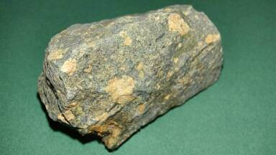
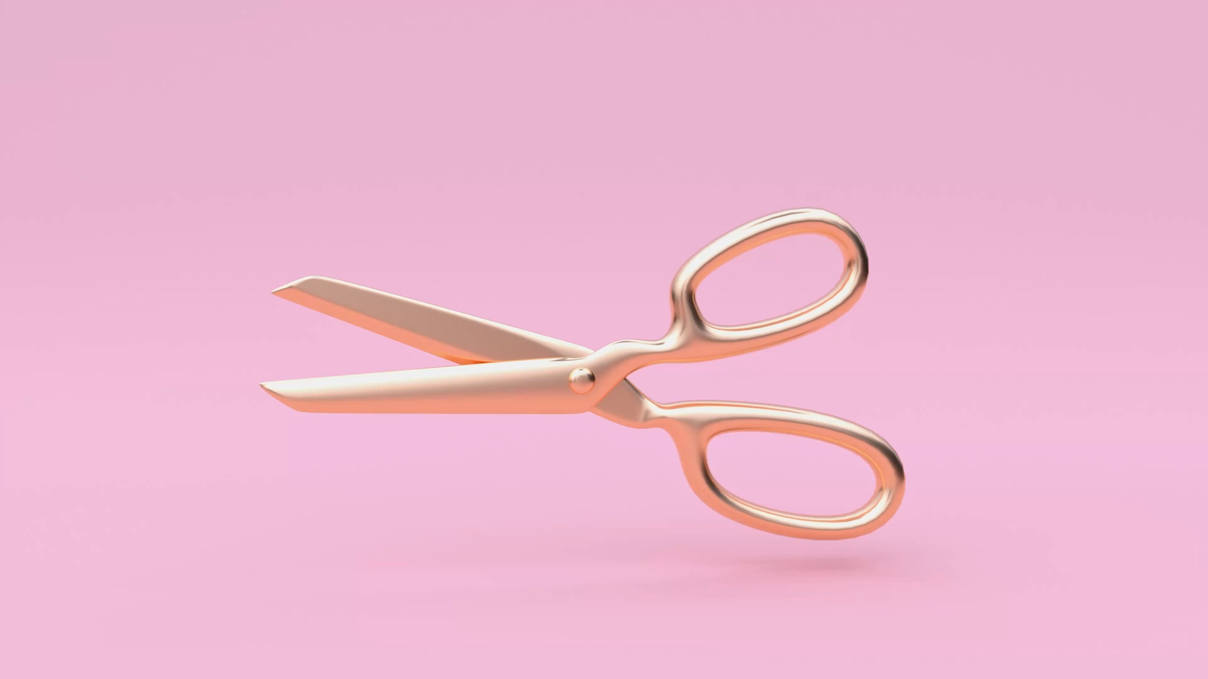

Rock-Paper-Scissors Advanced
Sean Osen
A few twists on an age-old classic; including score-keeping, man-bear-gun, and lizard-Spock.
Click here for repository on GitHub

